Slide 1

Process Management

Slide 2

Syllabus
Process Management
Process: Concept of a Process, Process States, Process Control-creation, new program execution, termination.
Threads: Processes and Threads, Concept of Multithreading, Types of Threads, Thread programming Using Pthreads.
Scheduling: Types of Scheduling, Scheduling Algorithms: FCFS, SJF, Priority, Round Robin.
OPERATING SYSTEMS
Notes:
MIT-WPU

Slide 3
References
1. William Stallings, Operating System: Internals and Design Principles, Prentice Hall, ISBN-10: 0-13-380591-3, ISBN-13: 978-0-13-380591-8, 8th Edition
2. Abraham Silberschatz, Peter Baer Galvin and Greg Gagne, Operating System Concepts, WILEY,ISBN 978-1-118-06333-0, 9th Edition
21/02/19
Operating system
Notes:
MIT-WPU

Slide 4
Process Management
Concept of a Process : Process is an instance of a program in execution
It is an entity that can be assigned to and executed on a processor
A process is comprised of:
  Program code/instructions
  Data
  Stack
  A number of attributes describing the state of the process
    When a process is mapped on to the memory it has an address space. This address space includes the code , data and stack for the process
Terms job, task and process are used almost interchangeably.
Many copies of editor program(passive entity) invoked, each is a separate process(active entity)
OPERATING SYSTEMS
Notes:
MIT-WPU

Slide 5
Process Management
  What is process management ?
  Processes are represented and controlled by the OS, this is known as process management.
  The Process states which characterize the behaviour of processes.
  The Data structures that are used to manage processes.
  It describes the ways in which the OS uses these data structures to control process execution.
OPERATING SYSTEMS
Notes:
MIT-WPU

Slide 6
Process Management tasks of an
Operating System
  Interleave the execution of multiple processes
  Allocate resources to processes, and protect the resources of each process from other processes,
  Enable processes to share and exchange information,
  Enable synchronization among processes.
Notes:
Explain that:
on a multiprogramming uniprocessor, the execution of multiple processes can be interleaved in time.
on a multiprocessor, not only may process execution be interleaved, but also multiple processes can execute simultaneously.
Explain that process management is compounded by the introduction of the concept of thread. In a multithreaded system,
the process retains the attributes of resource ownership,
The thread retains the attributes of multiple, concurrent execution streams running within a process.

Slide 7
Process States
When a program executes as a process it goes through multiple states before it completes execution
  new: process is created
  ready: process is waiting to be assigned processor. The process has every other resource except the processor
  running: Instructions are being executed. State has all resources including the processor
  waiting: process is waiting for some event to occur (eg. I/O completion). When an executing process needs an I/O device/services, it gets into wait state and when the i/o requirement is fulfilled it goes back into ready state
  terminated: process has finished execution

Slide 8

Diagram for Process States
OPERATING SYSTEMS
Notes:
MIT-WPU

Slide 9
Suspended State
Processor is faster than I/O so many processes could be waiting for I/O
Swap these processes to disk to free up more memory
Ready/Waiting state becomes suspend state when swapped to disk
Notes:
Mention that the aim is to fully utilize the processor.

Slide 10

Process Control Block (PCB)
Process Control Block [ PCB ] : It is a Data-structure maintained by the Operating System. It holds all necessary information related to a Process.
Information associated with each process is a follows:-
Process state
Program counter
CPU registers
CPU scheduling information
Memory-management information
Accounting information
I/O status information
OPERATING SYSTEMS
Notes:
MIT-WPU

Slide 11
Process Modes
There are two modes of operations :-
Kernel mode ( Privileged mode)..it can access its own data-structures as well as
the user mode data structures.
User mode : it can access only the user mode data structures.
User programs initially work in the User mode.
Whenever a system call is encountered the control switches to the kernel mode.
All interrupts are serviced in the Kernel mode.
When the system call is serviced the control returns back to the user mode
OPERATING SYSTEMS
Notes:
MIT-WPU

Slide 12
Process Management --- context switch
Requires the services of the kernel
For switching of context (environment) from Process A to process B, services of the kernel are needed. The kernel stores the execution environment (context) of process A and retrieves the environment(context) for process B for execution.
Every context switch is a mode switch.
Kernel mode
User mode
Process A
Process B
OPERATING SYSTEMS
Notes:
MIT-WPU

Slide 13
Context Switch
When CPU switches to another process, the system must save the state of the old process and load the saved state for the new process.
Context-switch time is overhead; the system does no useful work while switching.

Slide 14

Context Switch

Slide 15
Process Management – Mode switch
Kernel mode
User mode
Process A
Process A was executing in User mode and has now switched to the Kernel mode due to some system call. This is mode switch.
As, every context switch is a mode switch, every mode switch may/may not be a context switch.
Process A
OPERATING SYSTEMS
Notes:
MIT-WPU

Slide 16
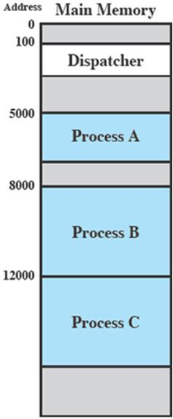
Process Execution
Consider three processes being executed
All are in memory (plus the dispatcher)
Dispatcher is a small program which switches the processor from one process to another
Selecting a process among various processes is done by scheduler. Here the task of scheduler completed. Now dispatcher comes into picture as scheduler have decided a process for execution, it is dispatcher who takes that process from ready queue to the running status, or providing CPU to that process is the task of dispatcher.

Slide 17
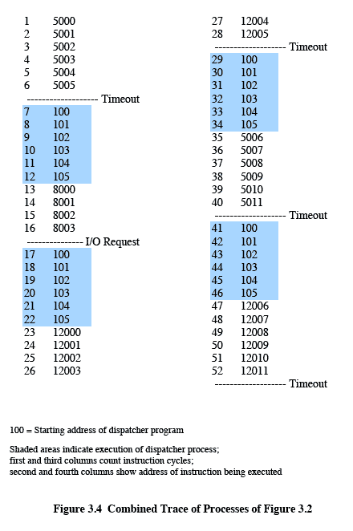
Process Execution
Timeout
Timeout
Timeout
I/O
Notes:
Animated slide
Explain the scenario then click for the animation
The shaded areas represent code executed by the dispatcher.
The same sequence of instructions is executed by the dispatcher in each instance because the same functionality of the dispatcher is being executed.
We assume that the OS only allows a process to continue execution for a maximum of six instruction cycles, after which it is interrupted; this prevents any single process from monopolizing processor time.
Animate here
The first six instructions of process A are executed, followed by a time-out and the execution of some code in the dispatcher, which executes six instructions before turning control to process B2.
After four instructions are executed, process B requests an I/O action for which it must wait. Therefore, the processor stops executing process B and moves on, via the dispatcher, to process C.
After a time-out, the processor moves back to process A. When this process times out, process B is still waiting for the
I/O operation to complete, so the dispatcher moves on to process C again.

Slide 18
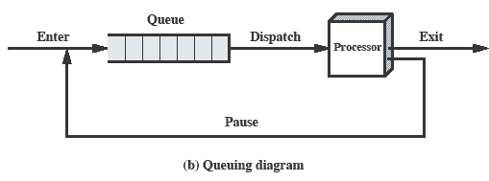
Queuing Diagram
Processes moved by the dispatcher of the OS to the CPU then back to the queue until the task is competed
Notes:
Animated slide The animation only shows one process moving.
There needs to be some structure so that the OS can keep track of the processes. This could be a simple queue which is managed by the dispatcher routine of the OS.

Slide 19
Process Creation
  When a new process is created , the following happens :-
Allocates space to the process in memory.
Assign a unique process ID to the process
A Process control block (PCB) gets associated with the process.
OS maintains pointers to each process’s PCB in a process table so that it can access the PCB quickly.
Reasons to create a new process
  New user Job
  Created by O/S to provide a service
  Spawned by existing process: The action of creating a new process (Child Process) at the explicit request of another process (Parent Process) is called as process spawning. E.g A print server or file server may generate a new process for each request that it handles
OPERATING SYSTEMS
Notes:
MIT-WPU

Slide 20
After Creation
After creating the process the Kernel can do one of the following:
  Stay in the parent process.
  Transfer control to the child process
  Transfer control to another process.
Notes:
When the kernel has completed these functions it can do one of the following, as part of
the dispatcher routine:
• Stay in the parent process. Control returns to user mode at the point of the fork call of the parent.
• Transfer control to the child process. The child process begins executing at the same point in the code as the parent, namely at the return from the fork call.
• Transfer control to another process. Both parent and child are left in the Ready to Run state.

Slide 21
Process Creation
Fork
System call fork() is used to create processes. It takes no arguments and returns a process ID.
The syntax for the fork system call
  pid = fork();
    In the parent process, pid is the child process ID
    In the child process, pid is 0
Sequence of operations for fork.
  1. It allocates a slot in the process table for the new process
  2. It assigns a unique ID number to the child process
  3. It makes a copy of the context of the parent process.
  4. It returns the ID number of the child to the parent process, and a 0 value to the child process.

Slide 22
Fork
Purpose of fork() is to create a new process, which becomes the child process of the caller.
After a process is created, both processes will execute the next instruction following the fork() system call.
To distinguish the parent from the child, the returned value of fork() can be used:
fork() returns a negative value, the creation of a child process was unsuccessful.
fork() returns a zero to the newly created child process.
fork() returns a positive value, the process ID of the child process, to the parent
Returned process ID is of type pid_t defined in sys/types.h
Process can use function getpid() to retrieve the process ID assigned to this process
Unix/Linux will make an exact copy of the parent's address space and give it to the child. Therefore, the parent and child processes have separate address spaces.
OPERATING SYSTEMS

Slide 23
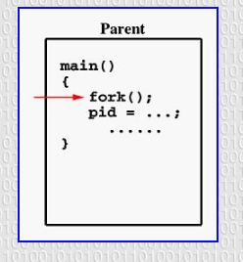

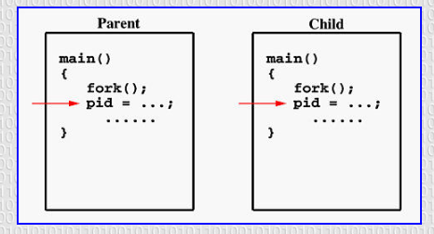
OPERATING SYSTEMS

Slide 24
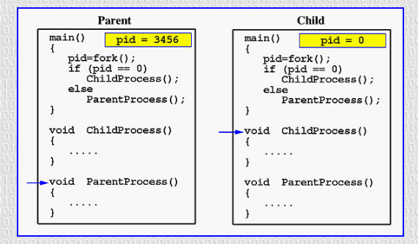
OPERATING SYSTEMS

Slide 25
Process Management—creating a Process in Unix(example)
#include<stdio.h>
#include<sys/types.h>
#include<unistd.h>
/* pid_t : is a long integer type data type...prototype in types.h */
pid_t num_pid;
main()
{
num_pid=fork(); /* return value of fork */
if(num_pid==0) /* this is child process */
{
printf("this is the child process id %d\n",getpid());
}
if(num_pid>0) /* this is parent process */
{
printf("this is the parent process id %d",getpid());
}
exit();
}
$cc program.c
$ ./a.out
this is the child process id 1001
this is the parent process id 1000
OPERATING SYSTEMS

Slide 26
Process Creation – Parent/Child
Parent Process
The parent process has its unique ID
The parent process creates a child process by giving a call to fork() system call
Child Process
The child process has its unique ID
The child process gets created due to the fork() system call
The child is initially a duplication of the parent process.
The child and parent do exist in separate address spaces.
The child inherits all data structures
A client-server application can be built using the parent-child concept.
Any IPC mechanism can be implemented using the parent child relationship.
OPERATING SYSTEMS

Slide 27
fork()
#include <stdio.h>
#include <sys/types.h>
#include <unistd.h>
int main()
{ fork();
printf("Hello world!\n");
return 0;
}
OPERATING SYSTEMS

Slide 28
fork()
#include <stdio.h>
#include <sys/types.h>
#include <unistd.h>
int main()
{ fork();
printf("Hello world!\n");
return 0;
}
Output:
Hello world!
Hello world!
OPERATING SYSTEMS

Slide 29
fork()
#include <stdio.h>
#include <sys/types.h>
int main()
{
fork();
fork();
fork();
printf("hello\n");
return 0;
}
OPERATING SYSTEMS

Slide 30
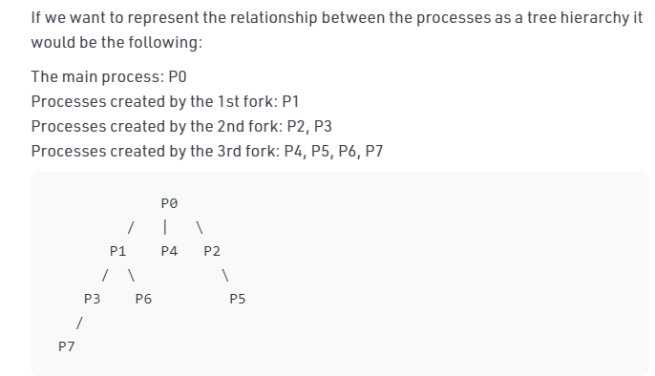
fork()
#include <stdio.h>
#include <sys/types.h>
int main()
{
fork();
fork();
fork();
printf("hello\n");
return 0;
}
Output:
hello
hello
hello
hello
hello
hello
hello
hello
here n = 3, 2³ = 8
OPERATING SYSTEMS

Slide 31
fork()
void forkexample()
{ if (fork() == 0)
printf("Hello from Child!\n");
else
printf("Hello from Parent!\n");
}
int main()
{
forkexample();
return 0;
}
OPERATING SYSTEMS

Slide 32
fork()
void forkexample()
{ if (fork() == 0)
printf("Hello from Child!\n");
else
printf("Hello from Parent!\n");
}
int main()
{
forkexample();
return 0;
}
Hello from Child!
Hello from Parent!
(or)
Hello from Parent!
Hello from Child!
.
Here, two outputs are possible because the parent process and child process are running concurrently. So we don’t know whether the OS will first give control to the parent process or the child process.
OPERATING SYSTEMS

Slide 33
fork()
void forkexample()
{ int x = 1;
if (fork() == 0)
printf("Child has x = %d\n", ++x);
else
printf("Parent has x = %d\n", --x);
}
int main()
{ forkexample();
return 0;
}
OPERATING SYSTEMS

Slide 34
fork()
void forkexample()
{ int x = 1;
if (fork() == 0)
printf("Child has x = %d\n", ++x);
else
printf("Parent has x = %d\n", --x);
}
int main()
{ forkexample();
return 0;
}
Parent has x = 0
Child has x = 2
(or)
Child has x = 2
Parent has x = 0
Here, variable change in one process does not
affect other process because data/state of
two processes are different. And also parent and
child run simultaneously, so two outputs are possible.
OPERATING SYSTEMS

Slide 35
Process Termination
When a process terminates :
All the resources held by process are released
All the information held in all data structures is removed
A process goes back to becoming a program and is stored on the secondary memory.
OPERATING SYSTEMS
Notes:
MIT-WPU

Slide 36
Process Management-- Threads
A thread is a part of a program.
It is an execution unit within a process
All threads of the same process share the same address space.
All Threads have separate stacks and individual Thread IDs
Thread is a lightweight process because :The context switching between threads is inexpensive in terms of memory and resources.
OPERATING SYSTEMS
Notes:
MIT-WPU

Slide 37
Process Management-- Threads
Multithreading: Ability of an OS to support multiple, concurrent paths of execution within a single process.
It is also described as the interleaved execution of threads.
OPERATING SYSTEMS
Notes:
MIT-WPU

Slide 38

Process Management– Differences between threads and processes
Process | Threads
A process is a program in execution | A thread is a part of the process
A process has its own Process ID | A thread has its own thread ID
Every process has its own memory space | Threads use the memory of the process they belong to
Inter process communication is slow as processes have different memory address | Inter thread communication for threads within the same process is fast
The context switching is more expensive in terms of memory and resources. | The context switching is less expensive in terms of memory and resources . Majorly because threads of the same process share the same memory space.
OPERATING SYSTEMS
Notes:
MIT-WPU

Slide 39
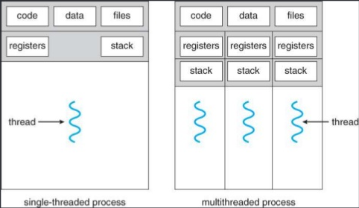
Process Management- ---
Threads, a diagrammatic representation
OPERATING SYSTEMS
Notes:
MIT-WPU

Slide 40
Threads and processes diagrammatic representation
Process Management
One process
one thread
One Process
Multiple threads
Multiple Processes
one thread per process
Multiple Processes
Multiple thread per process
OPERATING SYSTEMS
Notes:
MIT-WPU

Slide 41
Multithreading
Operating system supports multiple threads of execution within a single process
Examples:
  MS-DOS supports a single thread
  UNIX supports multiple user processes but only supports one thread per process
  Java run time environment supports one process with multiple threads
  Windows, Solaris, Linux, Mach, and OS/2 support multiple threads
OPERATING SYSTEMS

Slide 42
Process Management—Thread basics
Thread operations include thread creation, termination, synchronization (join, blocking), scheduling, etc.
All threads within a process share the same address space.
Threads in the same process share: Process instructions
  Data
  open files (descriptors)
  signals
  current working directory
  User and group id
Each thread has a unique: Thread ID
  set of registers
  stack for local variables, return addresses
  priority
OPERATING SYSTEMS
Notes:
MIT-WPU

Slide 43
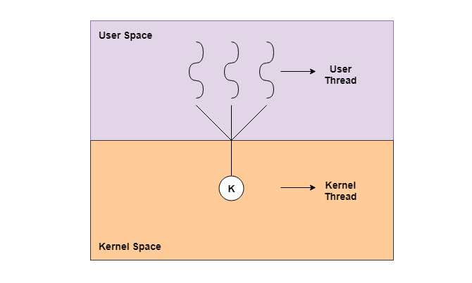
Process Management—Thread basics
Types of Threads :-
There are majorly two types of threads :-
1. kernel level threads
2. User level threads
OPERATING SYSTEMS
Notes:
MIT-WPU

Slide 44
Process Management—Thread basics
User - Level Threads
User-level threads are implemented by users and the kernel is not aware of the existence of these threads
Kernel handles them as if they were single-threaded processes.
User-level threads are much faster than kernel level threads.
They are represented by a program counter(PC), stack, registers and a small process control block.
Also, there is no kernel involvement in synchronization for user-level threads.
User-Level threads are managed entirely by the user-level library
OPERATING SYSTEMS
Notes:
MIT-WPU

Slide 45
Process Management—Thread basics
Advantages of User-Level Threads
User-level threads are easier and faster to create than kernel-level threads. They can also be more easily managed.
User-level threads can be run on any operating system.
There are no kernel mode privileges required for thread switching in user-level threads.
Disadvantages of User-Level Threads
Multithreaded applications in user-level threads cannot use multiprocessing to their advantage.
Entire process is blocked if one user-level thread performs blocking operation.
OPERATING SYSTEMS
Notes:
MIT-WPU

Slide 46
Process Management—Thread basics
Kernel-Level Threads
Kernel-level threads are handled by the operating system directly and the thread management is done by the kernel
Context information for the process as well as the process threads is all managed by the kernel.
Because of this, kernel-level threads are slower than user-level threads.
OPERATING SYSTEMS
Notes:
MIT-WPU

Slide 47
Process Management—Thread basics
Advantages of Kernel-Level Threads
Multiple threads of the same process can be scheduled on different processors in kernel-level threads.
The kernel routines can also be multithreaded.
If a kernel-level thread is blocked, another thread of the same process can be scheduled by the kernel.
Disadvantages of Kernel-Level Threads
A mode switch to kernel mode is required to transfer control from one thread to another in a process.
Kernel-level threads are slower to create as well as manage as compared to user-level threads.
OPERATING SYSTEMS
Notes:
MIT-WPU

Slide 48
Process Management—POSIX pthread
Portable Operating System Interface Standard (POSIX)
#include<pthread.h>
int pthread_create (pthread_t *tid, const pthread_attr_t *attr, void *(*func)(void*),void *arg);
0 : OK +ve : error
pthread_t *tid : Returns the thread ID which is of type pthread_t, i.e. long int.
const pthread_attr_t *attr : Thread attribute list
void *(*func)(void*) : A function that works as a thread.
void *arg : A list of arguments sent to the function
OPERATING SYSTEMS
Notes:
MIT-WPU

Slide 49
Process Management—POSIX pthread
Portable Operating System Interface Standard (POSIX)
#include <pthread.h>
void pthread_exit(void *retval);
The pthread_exit(); function terminates the calling thread and returns a value via retval (stores the return status of the thread terminated) that (if the thread is joinable) is available to another thread in the same process that calls pthread_join().
OPERATING SYSTEMS

Slide 50
Process Management—POSIX pthread
Portable Operating System Interface Standard (POSIX)
#include<pthread.h>
int pthread_join(pthread_t tid, void **status);
0:OK +ve:error
pthread_join() function shall suspend execution of the calling thread until the target thread terminates
On return from a successful pthread_join() call with a non-NULL status argument, the value passed to pthread_exit() by the terminating thread shall be made available in the location referenced by status.
OPERATING SYSTEMS

Slide 51
Process Management—POSIX pthread
Portable Operating System Interface Standard (POSIX)
#include<pthread.h>
pthread_t pthread_self(void);
Returns: thread ID of calling thread
The pthread_self() function returns the ID of the calling thread. This is the same value that is returned in *tid in the pthread_create() call that created this thread.
OPERATING SYSTEMS

Slide 52
Process Management--POSIX pthread
#include<pthread.h>
int pthread_detach(pthread_t tid);
Returns : 0:OK +ve: error
The pthread_detach() function marks the thread identified by thread as detached.
When a detached thread terminates, its resources are automatically released back to the
system without the need for another thread to join with the terminated thread.
Need for linking –lpthread flag at the time of compilation :-
-lpthread in essence tells the GCC compiler that it must link the pthread library to the compiled executable. pthread or POSIX Threads is a standardized library for implementing threads in C
OPERATING SYSTEMS
Notes:
MIT-WPU

Slide 53
pthread example
main()
{ int arr[4],a[3],b[3],i,ans=0;
pthread_t thread1,thread2;
printf("enter 4 numbers\n");
for(i=0;i<4;i++)
scanf("%d",&arr[i]);
a[0]=arr[0]; a[1]=arr[1];
b[0]=arr[2]; b[1]=arr[3];
pthread_create(&thread1,NULL,(void*)add1,a);
pthread_create(&thread2,NULL,(void*)add2,b);
pthread_join(thread1,NULL);
pthread_join(thread2,NULL);
ans=a[2]+b[2];
printf("the result = %d\n",ans);
}
#include<stdio.h>
#include<pthread.h>
int add1(int a[3])
{
a[2] = a[1] + a[0];
printf("result from thread 1 is %d\n",a[2]);
}
int add2(int b[3])
{
b[2] = b[1] + b[0];
printf("result from thread 2 is %d\n",b[2]);
}
OPERATING SYSTEMS

Slide 54
pthread example
#include <stdio.h>
#include <pthread.h>
int g = 0;
void myThreadFun(void *vargp)
{ int *myid = (int *)vargp;
static int s = 0;
++s; ++g;
printf("Thread ID: %d, Static: %d, Global: %d\n", *myid, ++s, ++g);
}
int main()
{ int i; pthread_t tid[3];
for (i = 0; i < 3; i++)
pthread_create(&tid[i], NULL, (void *) myThreadFun, &tid[i]);
pthread_exit(NULL);
return 0; }
OPERATING SYSTEMS

Slide 55

pthread example
#include <stdio.h>
#include <pthread.h>
int g = 0;
void myThreadFun(void *vargp)
{ int *myid = (int *)vargp;
static int s = 0;
++s; ++g;
printf("Thread ID: %d, Static: %d, Global: %d\n", *myid, ++s, ++g);
}
int main()
{ int i; pthread_t tid[3];
for (i = 0; i < 3; i++)
pthread_create(&tid[i], NULL, (void *) myThreadFun, &tid[i]);
pthread_exit(NULL);
return 0; }
Global and static variables are shared by all threads.
OPERATING SYSTEMS

